Slide 1
Internet and Social Media

Slide 2
God grant me the Serenity to accept the things I cannot change ~ Courage to change the things I can ~ and Wisdom to know the difference
Amen

Slide 3
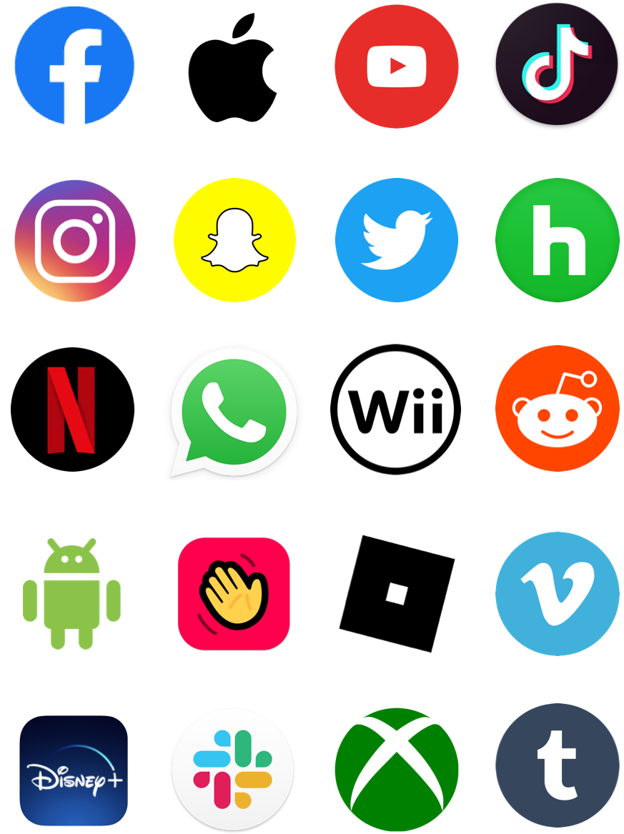
WARM UP: THINK-PAIR-SHARE
Think about what you share through digital media: text messages, social media, messaging apps, etc. How much of the real you comes through? How is the you that you present through digital media different from the face-to-face you?
Take a moment to think about the prompt. Then, discuss your thoughts with your partner.

Slide 5
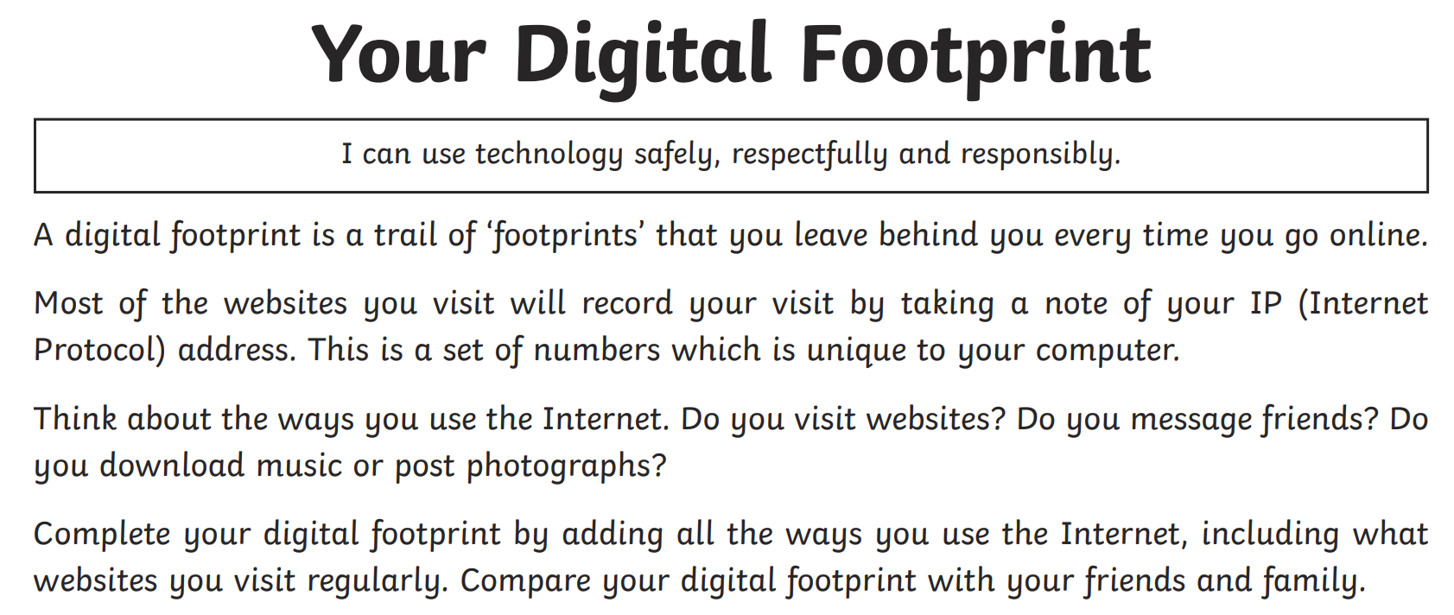
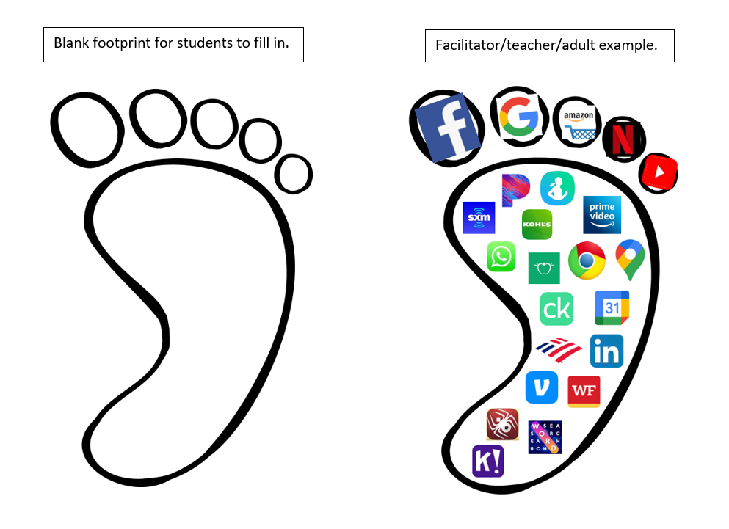

Slide 6
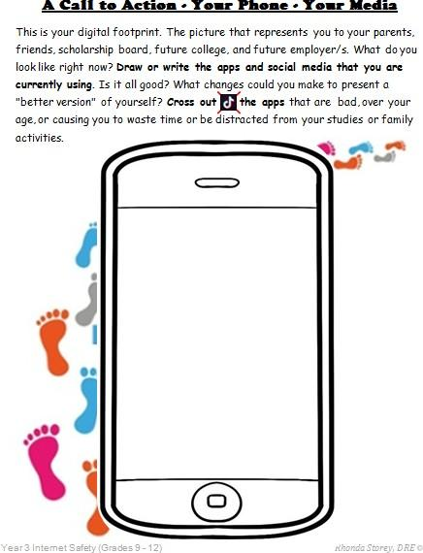

Slide 8
https://youtu.be/UhhYSrUHnao

Slide 14
Online Safety Rules
1. I will not give out personal information such as my address, telephone number, parents’ work address/telephone number, or the name and location of my school.
2. I will tell my parents or teacher right away if I come across any information that makes me feel uncomfortable or unsafe.
3. I will never agree to meet with an on-line “friend” off-line (in person) alone. If the person asking to meetup with me is legit, then they won’t mind meeting me with my mom, dad, or adult sibling. Unfortunately, sometimes people pretend to be someone they are not.
4. I will never send a person my picture, (in a school uniform or anything else) without first checking with my parents. I will never send a compromising or inappropriate photo of myself, a friend or even someone I don’t like. I will never use photo shop to hurt someone.
5. I will not respond to any messages that are mean or in any way make me feel uncomfortable. I will not say hurtful things about others or spread/share any kind of bullying messages.

Slide 15
6. I will follow family rules that are set for my safety and protection. I will be a good online citizen and not do anything that hurts other people or is against the law.
7. I will not give out any of my passwords to anyone (not even my best friend). I will keep my password list current with my parents. When I use a public computer, I will logout of the accounts I’ve accessed before leaving the terminal.
8. I will check with my parents before downloading or installing software, any App, or doing anything that could possibly hurt our devises or jeopardize my family’s privacy.
9. I will remember that there is absolutely nothing that is private online. Delete simply means I cannot see it anymore – it can still be in the Cloud or in someone’s screen shot.
10. I will remember that my parents and teachers just want me to be safe and protected. I will remember that my digital profile is what people will see when I want a scholarship, to get into a college, or my future job.

