Slide 1
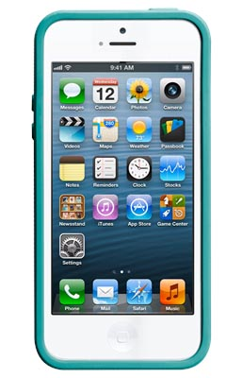
A
Cell Phone
Smartphone

Slide 2
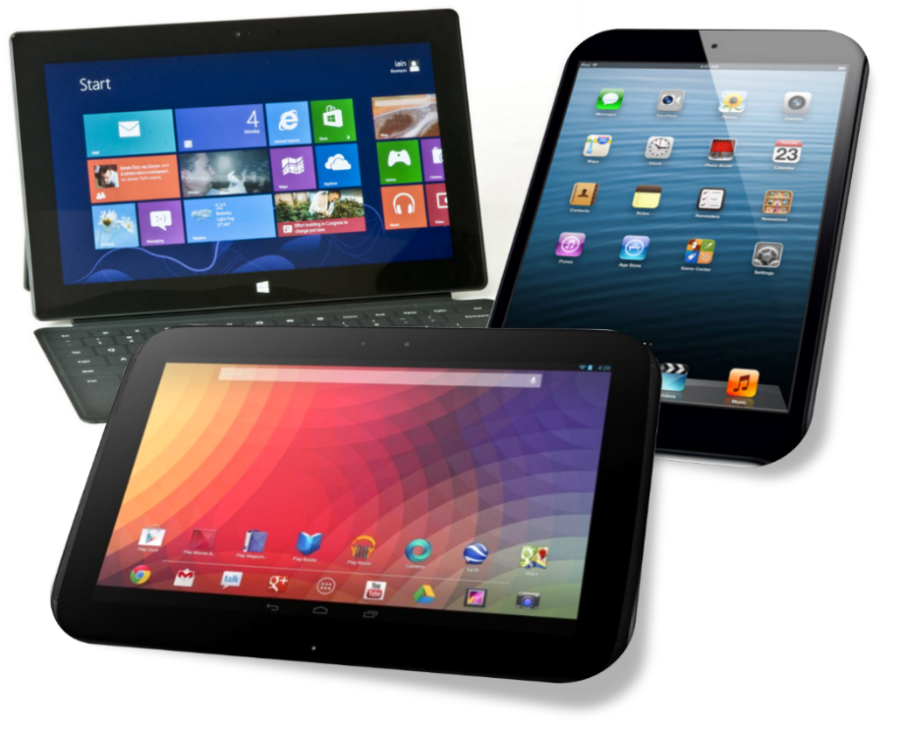
B
iPad
Tablet Chromebook

Slide 3
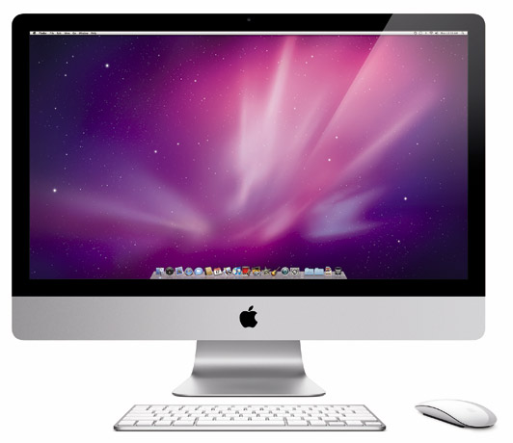
C
Computer
Laptop

Slide 4
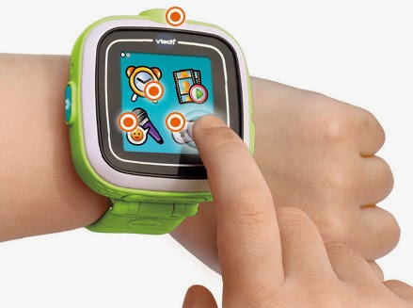
D
Smartwatch

Slide 5
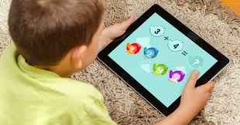
1
Play Games

Slide 6
2
Watch
YouTube

Slide 7
3
Listen to Music

Slide 8
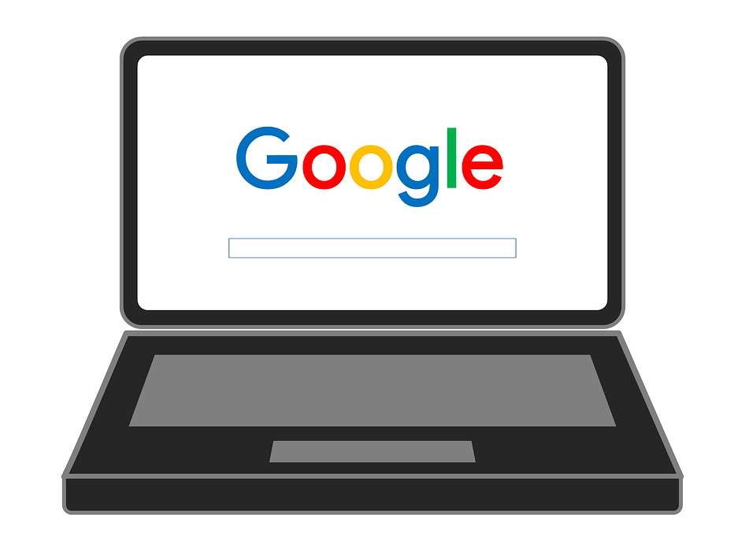
4
Google

Slide 9
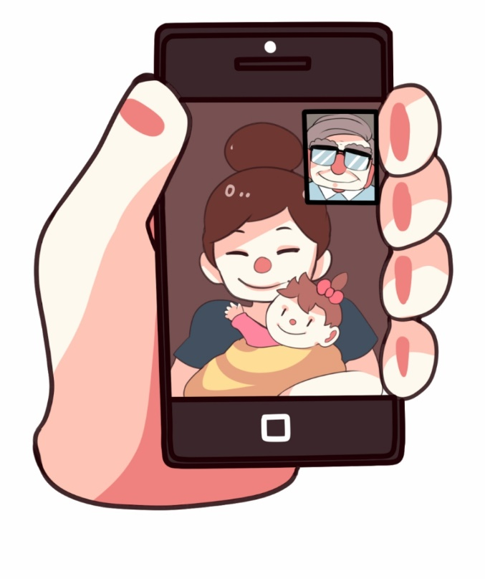
5
FaceTime
Skype

Slide 10
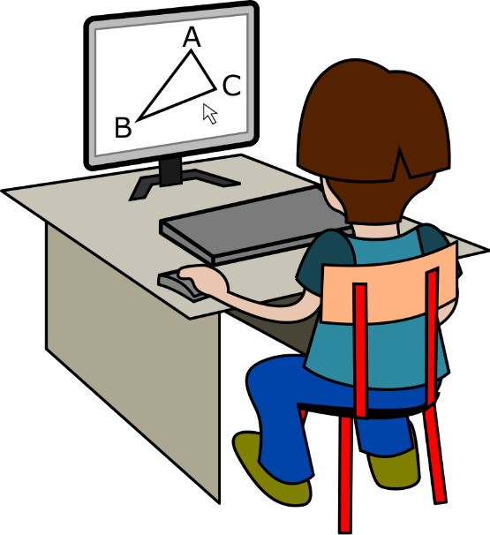
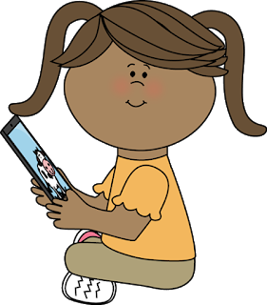
6
Do Homework Read

Slide 11
7
Take Pictures

Slide 12
8
Talk to People

Slide 13
9
Anything Else?

